Slide 1
Scheme – Friend or Foe?

Slide 2
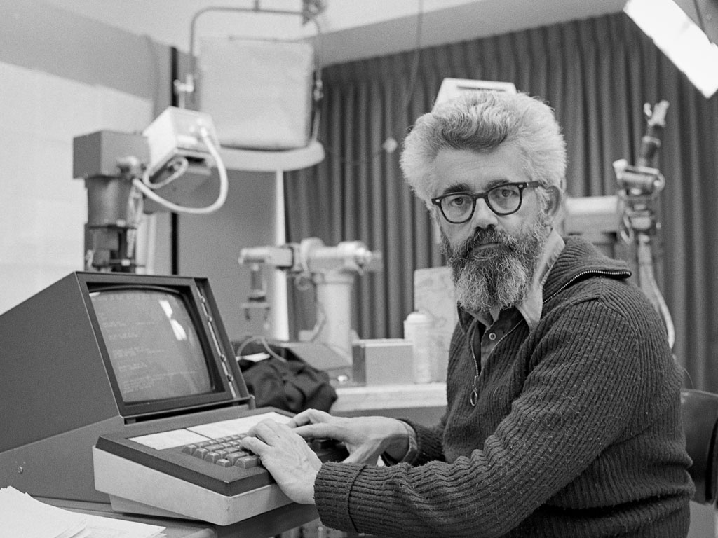
John McCarthy, inventor of Lisp

Slide 3
John McCarthy:
Invented the term Artificial Intelligence Invented Lisp, the first functional language
Invented time sharing
Invented the space fountain

Slide 4
John McCarthy:
Invented the term Artificial Intelligence Invented Lisp, the first functional language
Invented time sharing
Invented the space fountain

Slide 5
Lisp:
Created in 1958
One year younger than Fortran (1957)
One year older than Cobol (1959)
Based on syntax from Lambda Calculus
“To use functions as arguments, one needs a notation for functions, and it seemed natural to use the λ -notation of Church (1941). I didn't understand the rest of his book, so I wasn't tempted to try to implement his more general mechanism for defining functions.

Slide 6
Lisp:
Based on a few big ideas:
(Nearly) Everything is a list (LISt Processor)
REPL – Read Evaluate Print Loop
Non-mutability (“no” state)

Slide 7
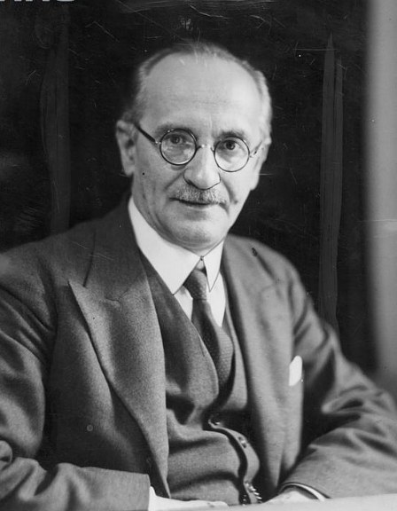
Polish Notation:
Named after Jan Łukasiewicz
Used extensively in Lisp
Very simple concept –
2 + 3 ➔ + 2 3
Operator first instead of in the middle
Helps with parsing – the parser knows what to expect right away

Slide 8
Lisp:
Let’s look at a simple example
( + 2 3)
5
Notice the parenthesis – you will come to hate love parenthesis

Slide 9
Scheme:
Scheme and Lisp are very similar, but the syntax on more complicated things is a little different, so let’s “switch” to Scheme syntax.

Slide 10
Scheme:
> ( + 2 3)
5
The > is just the prompt
Simple syntax is the same!

Slide 11
Scheme:
(define (factorial n)
(if (= n 0) 1
(* n (factorial (- n 1)))))
A little recursive function

Slide 12
Scheme:
Define a function “factorial” taking a parameter “n”
(define (factorial n)
(if (= n 0) 1
(* n (factorial (- n 1)))))
A little recursive function

Slide 13
Scheme:
If N = 0 then return 1 else…
(define (factorial n)
(if (= n 0) 1
(* n (factorial (- n 1)))))
A little recursive function

Slide 14
Scheme:
(define (factorial n)
(if (= n 0) 1
(* n (factorial (- n 1)))))
A little recursive function
Return N * the result of factorial of N - 1

Slide 15
Same Method in C#/Java
double factorial(double n)
{
if (n == 0) return 1;
return n * factorial (n-1);
}

Slide 16
Big Ideas:
I don’t see any of these big ideas!!!
Based on a few big ideas:
(Nearly) Everything is a list (LISt Processor)
REPL – Read Evaluate Print Loop
Non-mutability (“no” state)

Slide 17
Lists
Some of the instructions are … archaic for this stuff because history
Construct a list:
(cons 1 (cons 2 (cons 3 (cons 4 (cons 5 ‘())))))
Or let the compiler do it for you:
‘(1 2 3 4 5)
Quote here tells the system “don’t try to evaluate this list, just allocate for it and use it as data”

Slide 18
Lists
Take the first item from a list:
car (contents of address register)
>(car `(1 2 3 4 5))
1
Take the second through the end of the items from a list:
cdr (contents of the data register)
>(cdr `(1 2 3 4 5))
(2 3 4 5)

Slide 19
Lists
You can make lists of lists!
> '(1 2 3 (4 5 6) (7 8 9))
(1 2 3 (4 5 6) (7 8 9))
What will this give me?
>(car (cdr (cdr (cdr '(1 2 3 (4 5 6) (7 8 9))))))

Slide 20
Lists
You can make lists of lists!
> '(1 2 3 (4 5 6) (7 8 9))
(1 2 3 (4 5 6) (7 8 9))
What will this give me?
>(car (cdr (cdr (cdr '(1 2 3 (4 5 6) (7 8 9))))))
(4 5 6)

Slide 21
Definitions!
You can define names and assign “things” to them:
>(define mylist '(1 2 3 (4 5 6) (7 8 9)))
>(car mylist)
1

Slide 22
Isn’t this Functional Programming?
Where all my functions at?

Slide 23
Definitions!
You can also define functions. Remember our old friend factorial?
>(define (factorial n)
(if (= n 0) 1
(* n (factorial (- n 1)))))

Slide 24
Built ins
So now we have an idea how to define functions, we need to know how to DO something. There are some basic Boolean built-ins:
#t – true #f – false
null? – returns #t or #f if a list is empty (null? ‘()) ➔ #t
and – takes any number of arguments and returns #f if any are #f, otherwise it returns the last argument:
(and 1 2 3 4) ➔ 4 (and 1 2 #f 3 4) ➔ #f
or – takes any number of arguments and returns the first non #f, otherwise it returns #f:
(or 1 2 3 #f 4) ➔ 1 (or #f #f) ➔ #f
not – takes one argument and return #f UNLESS the argument was #f
(not 34) ➔ #f (not #f) ➔ #t

Slide 25
Built ins
cond – takes any number of conditions, returns the first true one
>(cond
(( > 1 2) "false 1")
(( > 4 5) "false 2")
(( < 6 7) "true 1")
(else "else"))
”true 1”
How else could you express the else clause?

Slide 26
Built ins
cond – takes any number of conditions, returns the first true one
>(cond
(( > 1 2) "false 1")
(( > 4 5) "false 2")
(( > 6 7) "true 1")
(#t "else"))
”else”

Slide 27
Built ins
There are TONS of built-ins:
odd? even? positive? negative? zero?
You have seen the < > = operators
list? – is the parameter a list?
pair? is the parameter a list with at least one cons (item)?
null? is the parameter an empty list?
(display x) – prints x to the screen

Slide 28
Built ins
Things you can do with lists:
(reverse ‘(1 2 3)) ➔ (3 2 1)
(length ‘(4 5 6)) ➔ 3
(member 4 ‘(1 2 3 4 5 6)) ➔ (4 5 6) – cdr starting at search element
(append ‘(1 2) ‘(3 4)) ➔ (1 2 3 4)
Many more (read the documentation!)

Slide 29
Equality
You compare two numbers with (=):
You compare two strings with (equal?):
(= 5 5)
#t
(= 5 4)
#f
(equal? “5” “5”)
#t
(equal? “5” “4”)
#f

Slide 30
Local Variables
It isn’t true that Functional Languages have NO variables, they just aren’t global...
>(let ((i 1) (j 2))
(+ i j))
3
Notice, though, the scoping rules – i & j are only valid WITHIN the let ”statement”.

Slide 31
Lambda – IMPORTANT IDEA
A lambda is an unnamed function. These are really handy for those cases where you need to define a function and use it only once. Otherwise you end up filling your program with functions that you can’t reuse and don’t care about but that you have to look through when you
>(
(lambda(n)
(+ n 1)
)
5
)
6

Slide 32
Local Variables
Functions can also be assigned to a local variable!
>(define (quadruple x)
(let ((double (lambda (y)
(+ y y))))
(double(double x))))

Slide 33

Higher Order Functions – IMPORTANT IDEA
Higher order functions are functions that take other functions as a parameter

Slide 34
Higher Order Functions
Example
(define (printwhere fn ls)
(begin
(if (fn (car ls )) (begin (display (car ls))(newline) ))
(if (not (null? (cdr ls))) (printwhere fn (cdr ls)))
))

Slide 35
Higher Order Functions
Remember, no types! fn is a function
ls is a list
Example
(define (printwhere fn ls)
(begin
(if (fn (car ls )) (begin (display (car ls))(newline) ))
(if (not (null? (cdr ls))) (printwhere fn (cdr ls)))
))

Slide 36
Higher Order Functions
Begin – do more than one thing; usually considered bad form in Scheme
Example
(define (printwhere fn ls)
(begin
(if (fn (car ls )) (begin (display (car ls))(newline) ))
(if (not (null? (cdr ls))) (printwhere fn (cdr ls)))
))

Slide 37
Higher Order Functions
Call function fn passing in the car (first element of) the list. If it returns true, print the car plus a newline
Example
(define (printwhere fn ls)
(begin
(if (fn (car ls )) (begin (display (car ls))(newline) ))
(if (not (null? (cdr ls))) (printwhere fn (cdr ls)))
))

Slide 38
Higher Order Functions
If the cdr (the rest of the list) is not null, then call printwhere on the rest of the list
Example
(define (printwhere fn ls)
(begin
(if (fn (car ls )) (begin (display (car ls))(newline) ))
(if (not (null? (cdr ls))) (printwhere fn (cdr ls)))
))

Slide 39
Higher Order Functions
A few built in examples:
>(map + ‘(1 2 3) ‘(4 5 6))
(5 7 9)
> (for-each display '(1 2 3 4))
1234
> (for-each (lambda (x) (let ((y (+ x 1)))(display y)))'(1 2 3 4))
2345

Slide 40
Map/Reduce
Not a new idea (has roots in mergesort from the 40’s!), but Google made it more famous recently
A simple concept – lots of nodes do most of the work, then roll it up to some master nodes who finish the work
A simple example – you want to average a million numbers

Slide 41
Send 100,000 numbers to each node along with the “instruction” (lambda, pre-defined function, etc) to “sum”
Master Node
Node
Node
Node
Node
Node
Node
Node
Node
Node
Node

Slide 42
Each node returns the sum of the numbers; master node now can add those 10 numbers and divide by 1,000,000!
Master Node
Node
Node
Node
Node
Node
Node
Node
Node
Node
Node

Slide 43
What tool to use?
There are several scheme interpreters out there.
I used:
https://download.racket-lang.org/
And that’s what I will use to evaluate your code…

